Slide 1
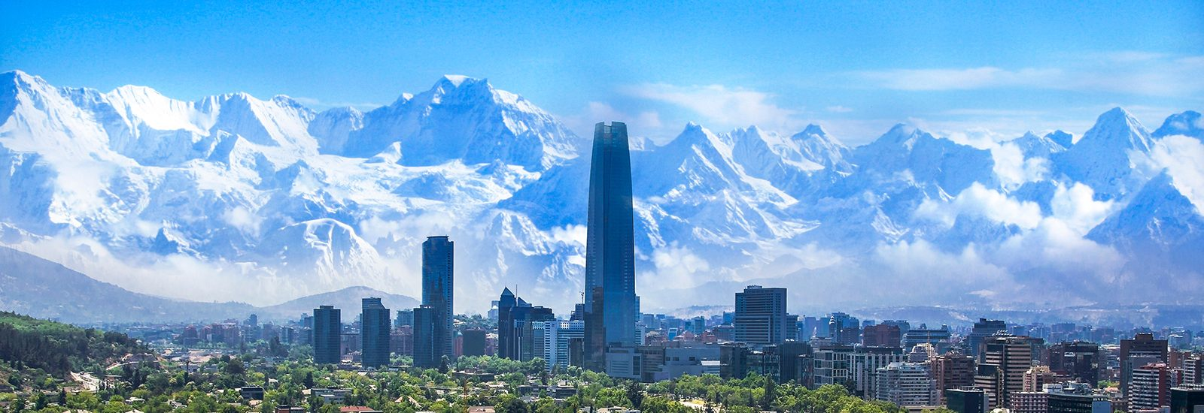
Global Seminar:
Revelle in Santiago
Summer Session II, 2025
Bretton Rodriguez, Ph.D.

Slide 2
Outline
Introduction
Chile
Courses
Excursions

Slide 3
Bretton Rodriguez, Ph.D.
From: Chicago, IL
University of Chicago – BA in History and English Literature
University of York – MA in Medieval Studies
University of Notre Dame – Ph.D. in Literature

Slide 4
Bretton Rodriguez, Ph.D.
The Bosporus University in Istanbul – Visiting Assistant Professor of Humanities
University of Nevada, Reno – Teaching Associate Professor, Assistant Director of Core Humanities
University of California San Diego – Associate Director of the Humanities Program
Research: Ideas and Uses of History, Spanish Literature, Writing and Rhetoric

Slide 5
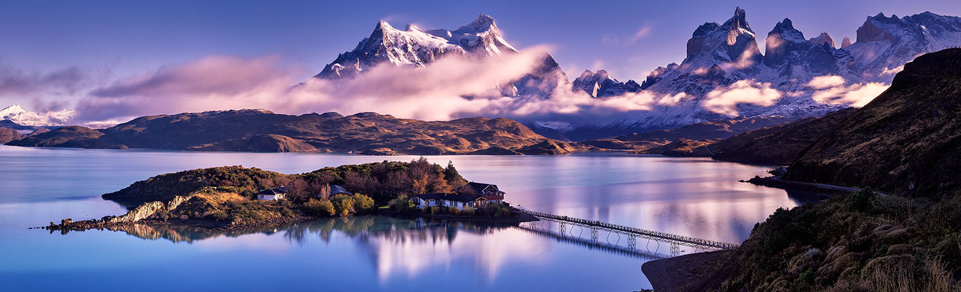
In Latin America
Taught English: Chile and Mexico (Oaxaca)
Service Trips: Costa Rica
Language Immersion Trips: Argentina and Ecuador

Slide 6
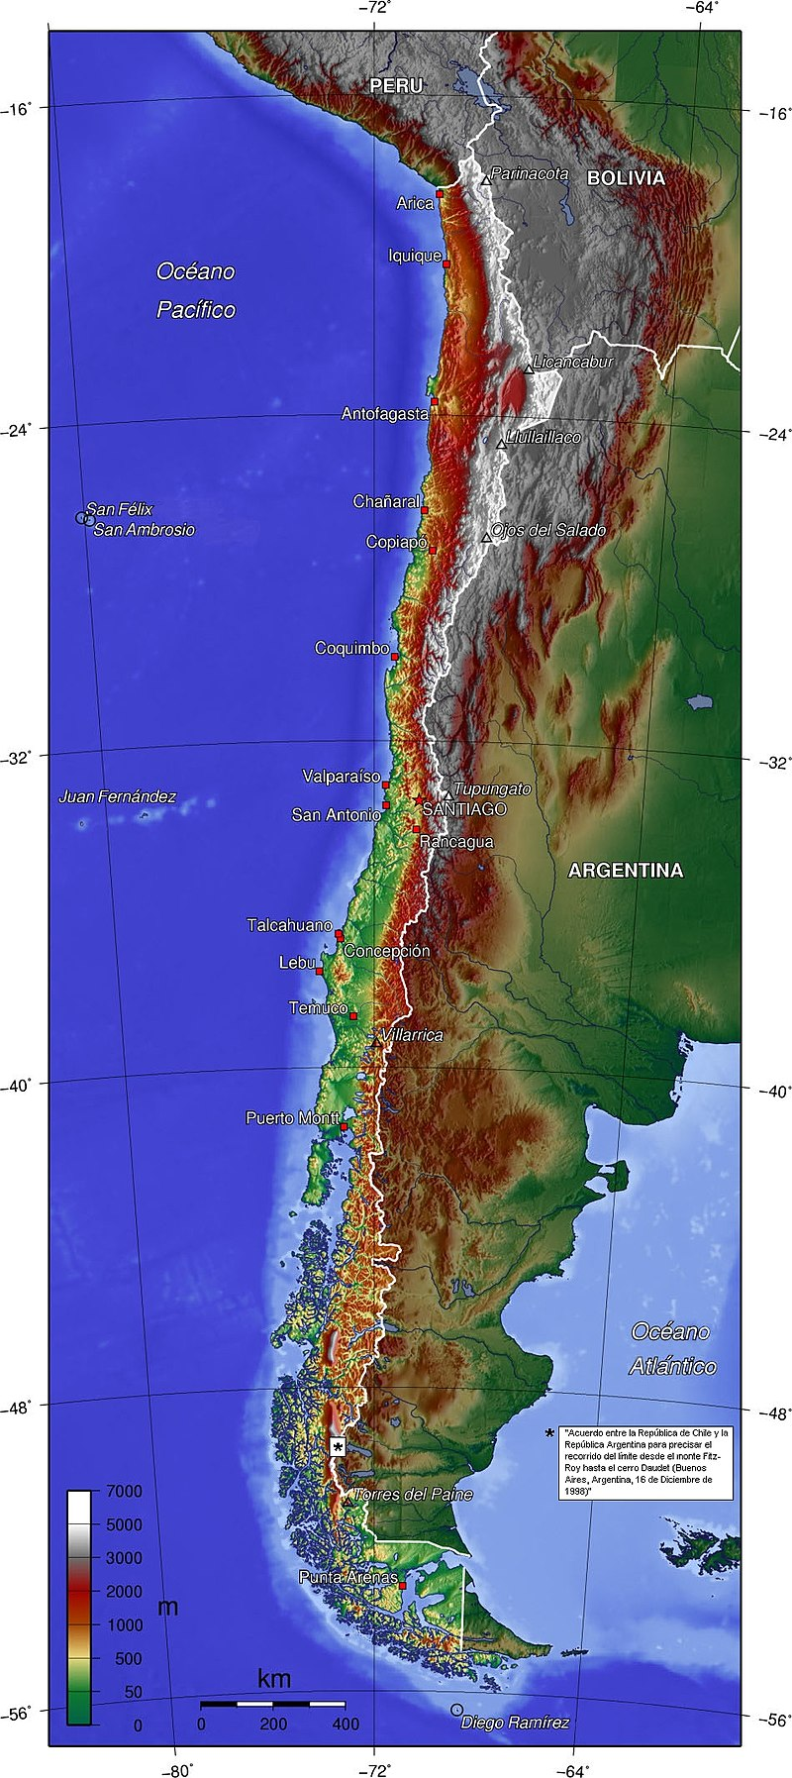
Chile
Population: 18.6 million
Language(s): Spanish (95%), English (10%), Indigenous languages (1%)
Capital: Santiago
More Info: CIA Factbook
Incredible Geodiversity

Slide 7
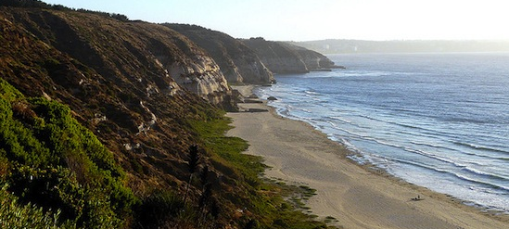
The Pacific Ocean

Slide 8
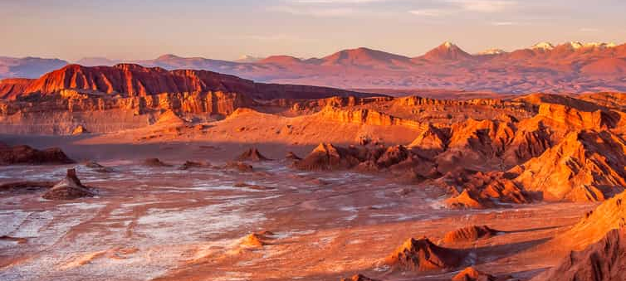
The Atacama Desert

Slide 9
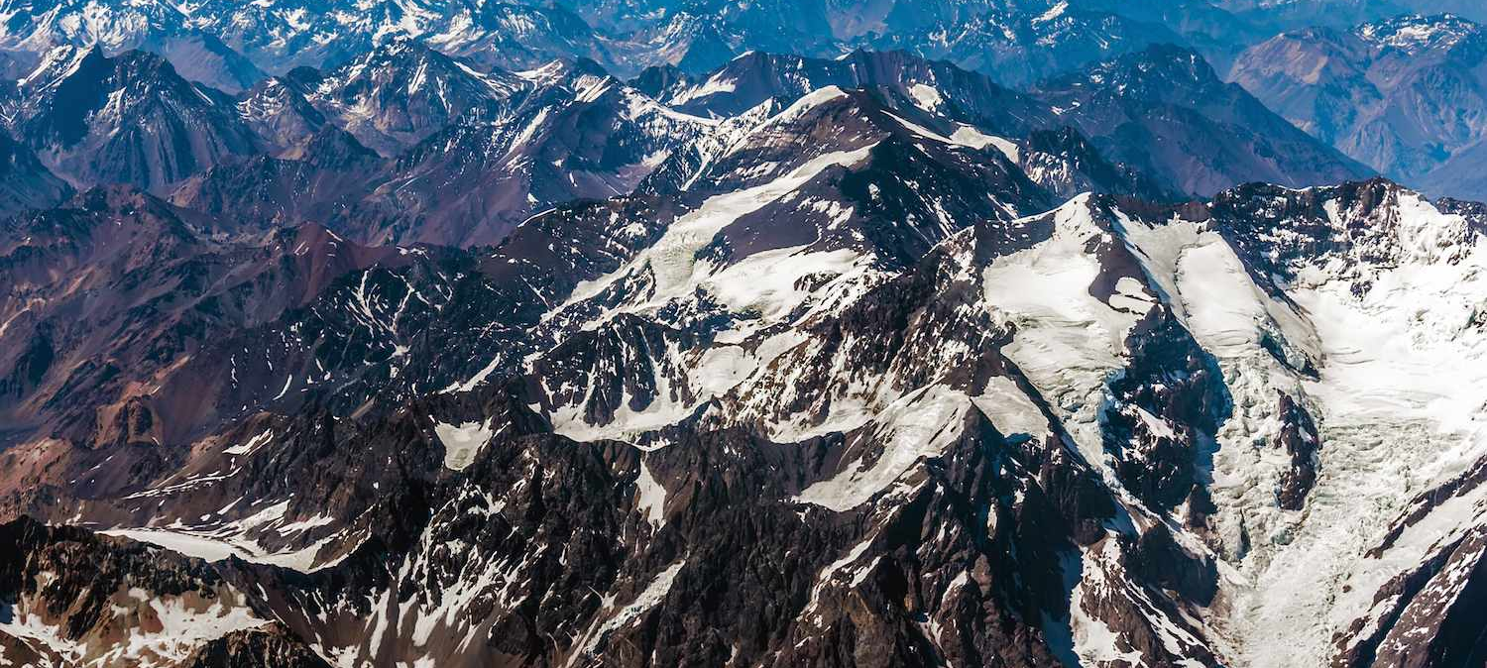
The Andes Mountains

Slide 10
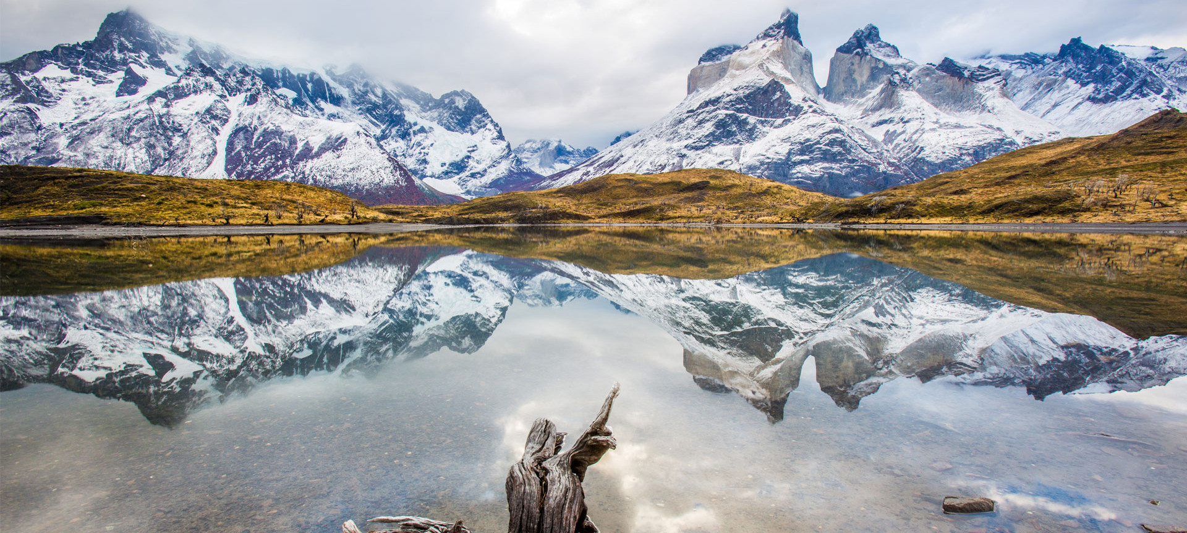
Patagonia

Slide 11
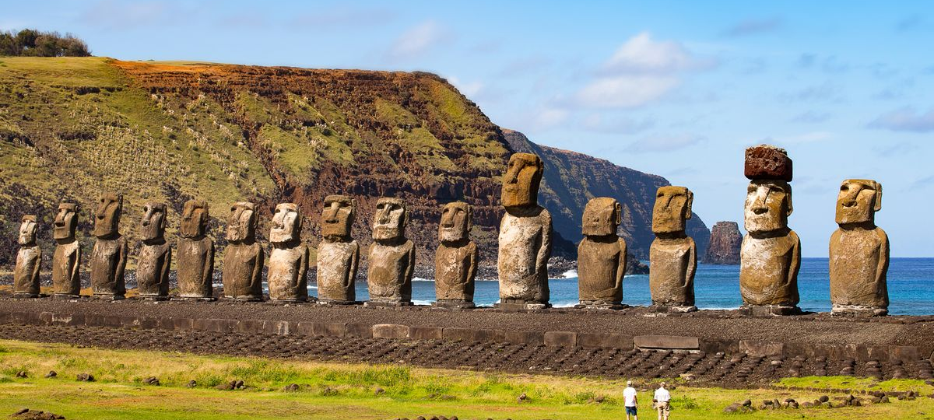
Easter Island

Slide 12
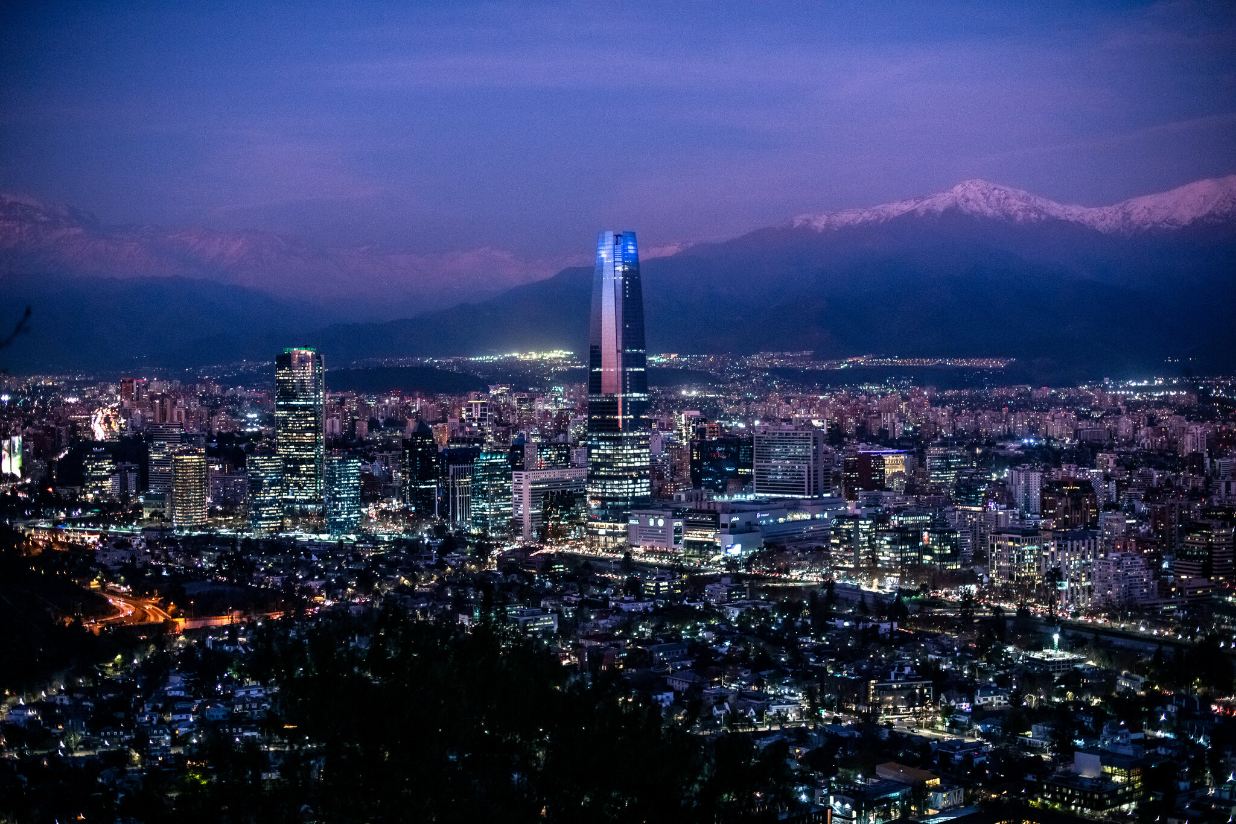
Santiago
Founded in 1541
Modern city of 7 million people (metropolitan area)
World-class universities and museums
Fantastic restaurants, music, and nightlife
Excellent infrastructure and transportation
Clean, safe, and friendly

Slide 13
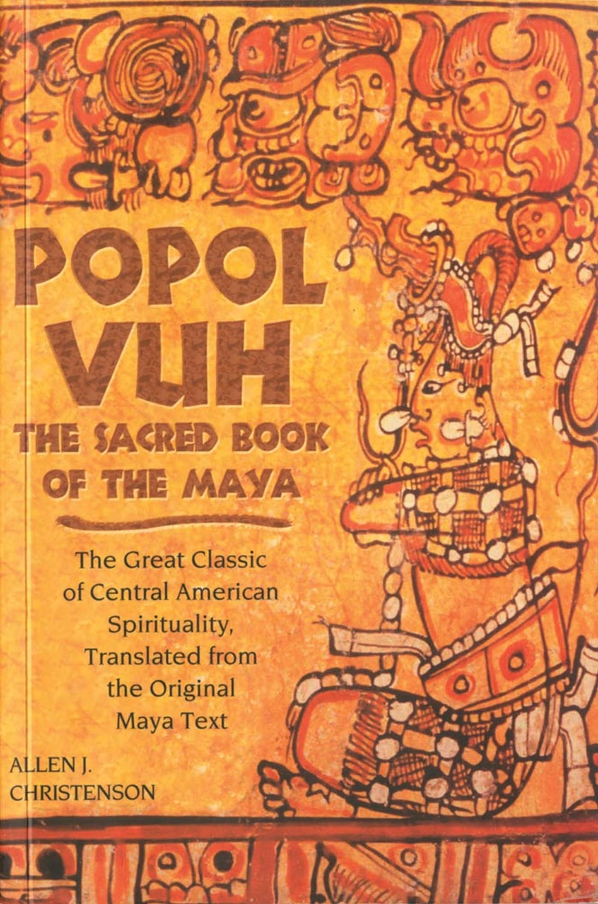
Courses
HUM 3GS: Renaissance, Reformation, and Early Modern Europe
LTAM 110GS: Latin American Literature in Translation
Course Credit: 2 HUM courses (HUM 3 and either HUM 4 or HUM 5)

Slide 14
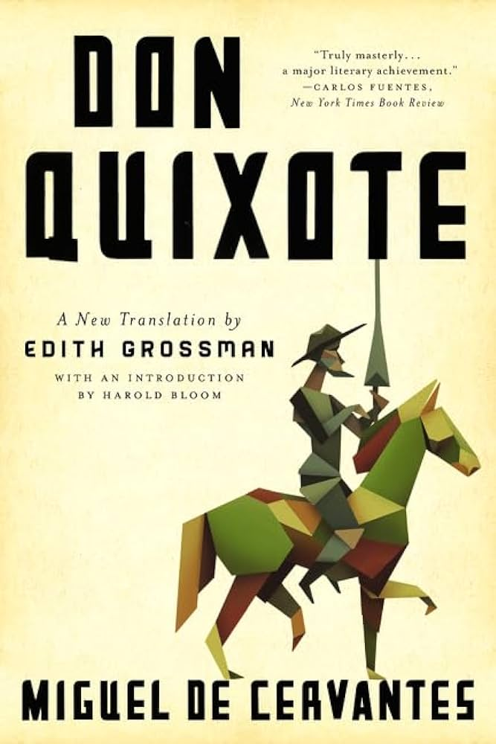
HUM 3GS: Description
In HUM 3GS, we move from the classical and medieval worlds into the Early Modern Period. During this period, we see the impact of the shock encounter between the cultures and civilizations of Europe and those of the Americas along with the development of new ideas and traditions that become foundational in Western societies. Through the course, we will explore the impact of this encounter between Europe and America as well as the origins of many ideas and beliefs that still shape our world today.

Slide 15
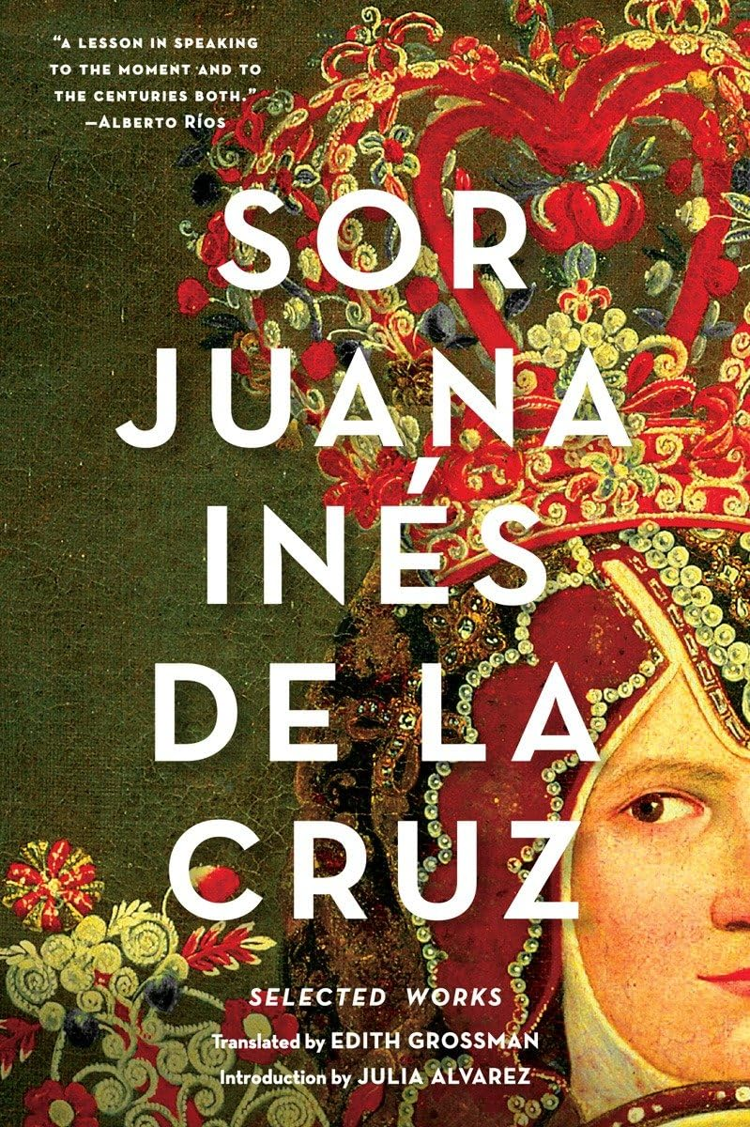
HUM 3GS:
Select Authors and Texts
Mexica Accounts of the Spanish Conquest
Niccolò Machiavelli
Miguel de Cervantes
William Shakespeare
Sor Juana Inés de la Cruz

Slide 16
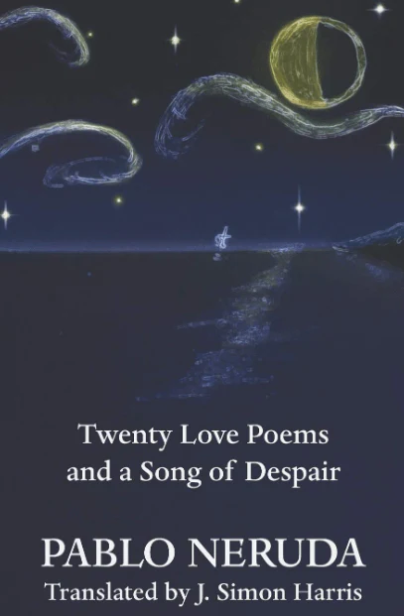
LATM 110GS: Description
In LTAM 110GS, we examine the development of Latin American Literature from the indigenous societies that pre-dated the arrival of European settlers up to the present day. In doing so, the course provides a broad exploration of the origins of Latin American literature, and it highlights some of the ways that colonization has impacted and shaped Latin American society and culture. Through this course, students will engage with some of the most influential Latin American texts and authors within a larger framework that puts those texts into context and conversation with one another.

Slide 17
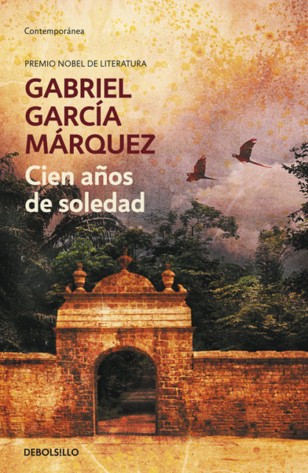
LATM 110GS:
Select Authors and Texts
The Popol Vuh
Jorge Luis Borges
Gabriela Mistral
Pablo Neruda
Isabelle Allende
Gabriel García Márquez

Slide 18
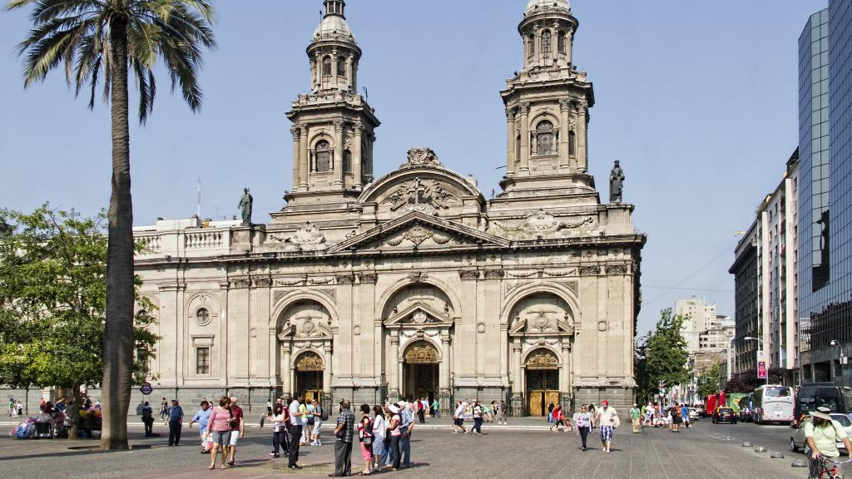
Select Excursions

Slide 19
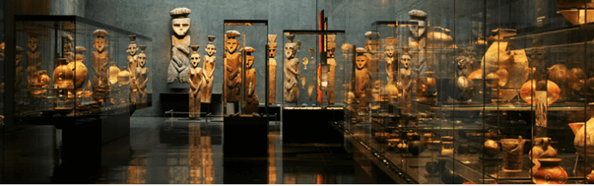
Chilean Museum of Pre-Columbian Art

Slide 20
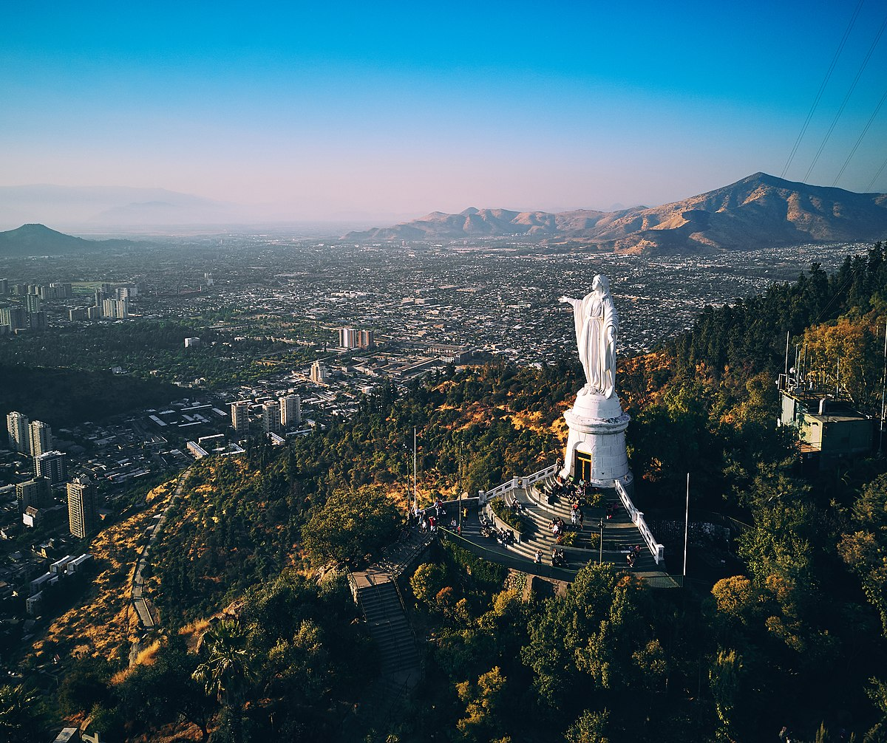
San Cristóbal Hill

Slide 21
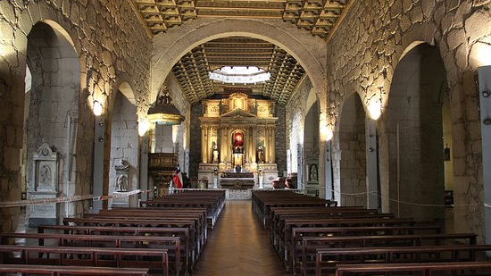
The Church and Convent of San Francisco

Slide 22
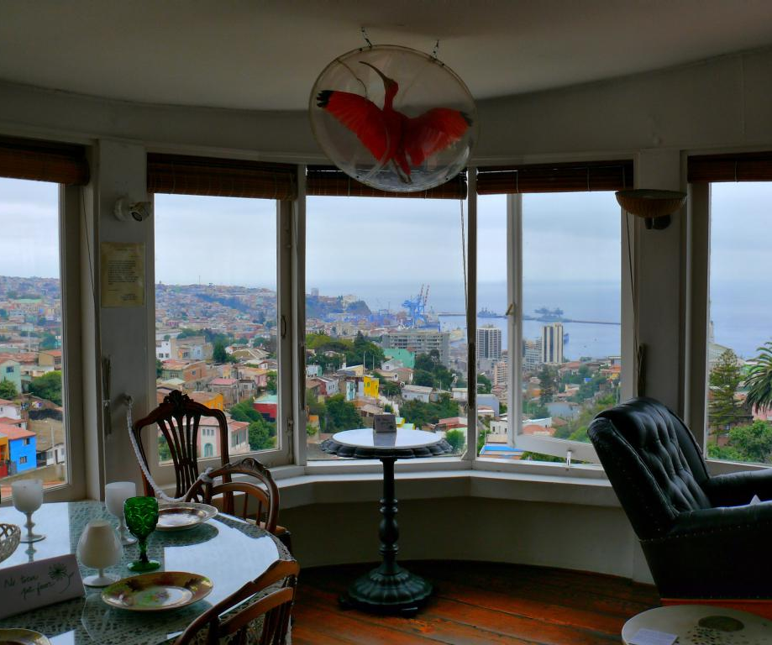
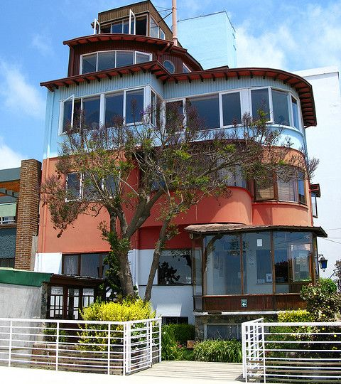
La Sebastiana Museum

Slide 23
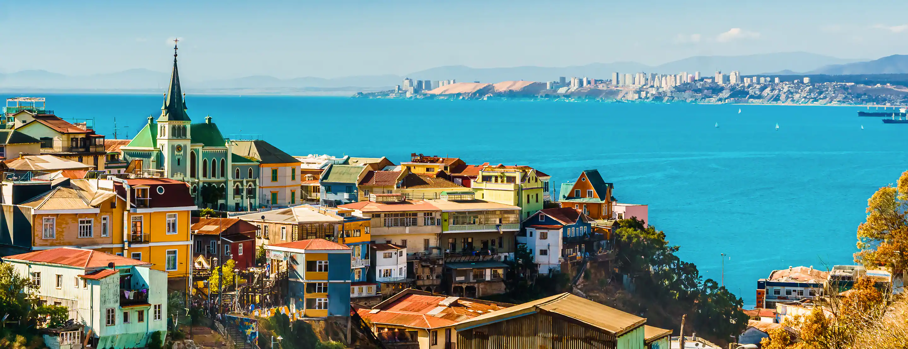
Valparaíso

Slide 24
Questions?

